Slide 1

Department of CSE
Course: AI & ML
Course code: 24AD2001A
Topic:
Ethics, Fairness, Explainability: Bias sources, mitigation.
Session – 38

Slide 2
Ethics in Machine Learning
Machine learning ethics is a multidisciplinary field that draws upon philosophy, computer science, and social sciences to address the ethical challenges posed by the increasing use of machine learning algorithms. It explores the ethical implications of algorithmic decision-making and seeks to ensure that these systems are developed and used in ways that are fair, transparent, and respectful of individual rights.
Machine learning algorithms are increasingly used in various domains, including healthcare, finance, criminal justice, and education. These algorithms have the power to make decisions that, without human judgment, can have significant consequences for individuals and communities. Therefore, it is crucial to consider the ethical dimensions of machine learning to prevent potential harm and ensure that the data created by these systems are used responsibly.

Slide 3
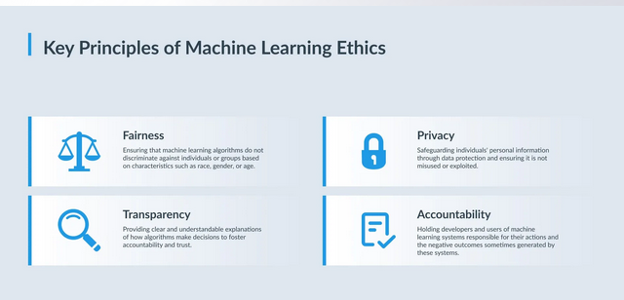
Key Principles of Machine Learning Ethics

Slide 4
Ethics in ML
Societal impact: ML projects should aim to benefit society and avoid harm, bias, or misuse.
Privacy: This includes protecting personal data, adhering to regulations, and ensuring secure data handling.
Transparency: Model functionality and decision-making processes should be understandable and documented.
Safety and reliability: Models should be designed to operate securely and reliably.

Slide 5
Fairness:
Ensuring that machine learning algorithms do not discriminate against individuals or groups based on characteristics such as race, gender, or age. Fairness is a critical principle in machine learning ethics as it seeks to eliminate biases and promote equal treatment.
For example, in the context of hiring algorithms, fairness means that the algorithm should not favor any particular group or discriminate against certain individuals based on protected characteristics. It requires careful consideration of the training data, evaluation metrics, and potential biases that may be present in the algorithm.

Slide 6
CONTD..
Definition: Fairness in ML means that models do not unfairly disadvantage any individual or group based on protected characteristics like gender, race, or age.
Bias mitigation: It requires addressing biases that may be present in training data, as well as in the algorithm itself.
Examples: In hiring or lending, a fair algorithm should not favor one group over another based on characteristics unrelated to their qualifications.
Metrics: Fairness can be evaluated using quantitative metrics like equality of opportunity, predictive equality, or calibration.
Challenges: Defining and achieving fairness is complex and can be controversial, as the reasons for unfairness extend beyond just technical aspects of data and algorithms.

Slide 7
Explainability: Bias sources
Explainability in machine learning is the process of explaining to a human why and how a machine learning model made a decision. Model explainability means the algorithm and its decision or output can be understood by a human. It is the process of analyzing machine learning model decisions and results to understand the reasoning behind the system’s decision. This is an important concept with ‘black box’ machine learning models, which develop and learn directly from the data without human supervision or guidance.
Machine learning models are increasingly replacing traditional software or processes in a range of settings. The ability to explain a decision is a vital part of any business or organization. The hands-off nature of machine learning model development and evolution means it’s difficult to clearly explain a model’s decision making. This lack of clarity means a model may be misunderstood or mistrusted in the wider organization. In turn, the effectiveness of the model to improve the organization will be impacted.
Model explainability is vital in environments that are regulated or audited. In many business settings, decisions can and will be challenged by external parties. For example, machine learning in banking may automate the screening of loan or mortgage applicants. The reason why a loan applicant was rejected is important internally and externally, as financial decisions are often scrutinized.

Slide 8
Types of model explainability
machine learning explainability tools are classified between three main areas:
Local model explainability
Cohort model explainability
Global model explainability
Local Explainability: Explains why a model made a specific prediction for a single data point. For example, why was a particular loan application approved or denied?
Global Explainability: Focuses on understanding the model's behavior as a whole. It looks at the overall contribution of different features to the model's predictions.

Slide 9
CONTD..
Cohort model explainability: It is a type of Explainable AI (XAI) that focuses on explaining the behavior of a machine learning (ML) model on specific subgroups, or "cohorts," of data. Instead of explaining individual predictions (local explainability) or the model's overall logic (global explainability), this approach provides context-specific insights that balance detail with conciseness.

Slide 10
Trade-off: Performance vs Explainability
Often, more complex models (e.g. deep networks, ensembles) have higher performance but lower interpretability.
Simpler models (linear, decision trees) easier to explain but might underperform
Need to balance: “as simple as possible but as complex as needed”
Overview of Bias in ML:
systematic errors or unfairness in predictions, affecting specific groups.
Bias can enter at multiple stages of ML pipeline: data, modeling, deployment
Classifications: data bias, algorithmic bias, human/user bias

Slide 11
Bias sources
Bias in machine learning (ML) models arises from multiple sources throughout the development lifecycle, from data collection to deployment
These systematic errors lead to unfair, inaccurate, or discriminatory outcomes and often reflect and reinforce existing human and societal biases. Explainability is a field of AI that helps identify and mitigate these biases by making the model's decision-making process transparent.
For example, having prior domain knowledge (i.e., bias) helps in devising legitimate constraints that determine which solution space to explore and which to prune. Bias (or prior knowledge in statistical terms) may be used in ML to model actual knowledge of data, intended use of learned generalizations and even knowledge about training data.

Slide 12
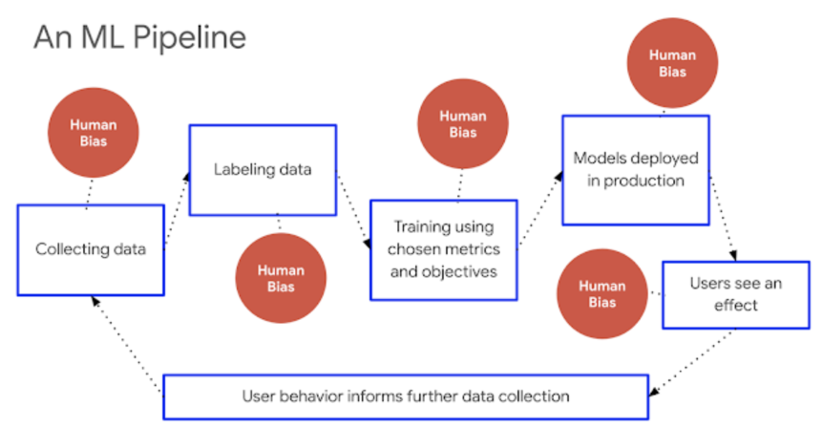
Bias in data and Ml

Slide 13
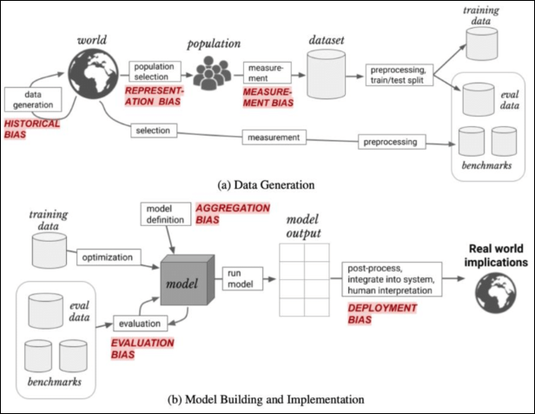
Bias types

Slide 14
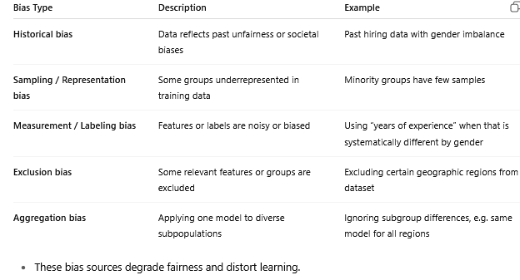
>Data-Level Bias Sources

Slide 15
>Modeling / Algorithm-Level Bias
Inductive bias: the assumptions built into the algorithm (e.g. linear models assume linear relationships) Wikipedia
Regularization bias: penalizing complexity might favor certain groups
Feature selection bias: choosing features that favor or disadvantage groups
Algorithmic mis-specification: wrong objective or loss that skews toward particular groups
Confirmation / overfitting bias: model fits training data too closely including biased patterns

Slide 16
>Evaluation & Deployment Bias
Evaluation bias: test dataset not representative; metric misalignment across groups
Feedback loop / Deployment bias: model decisions change future data distribution, reinforcing bias
Context shift / selection bias: real-world environment differs from training setting
User bias / Interaction bias: users interact in biased ways, influencing model adaptation
Bias Lifecycle Across ML Pipeline
Phases: Problem conception → Data collection → Preprocessing → Model training → Evaluation → Deployment → Monitoring
At each phase, specific biases can occur
Importance of continuous auditing and mitigation

Slide 17
How Explainability Helps Detect Bias
By providing transparency, it reveals which features the model uses heavily
Local explanations can show how different groups are treated
Enables fairness debugging: comparing explanations across subgroups
Helps stakeholders (users, regulators) understand and question model behavior
Example: Loan Approval System
Suppose model uses features like income, credit history, zip code (which correlates with race)
Explainability methods (SHAP, LIME) reveal that zip code heavily influences decisions
That can hint at bias: model leveraging proxy for sensitive attribute
Use the insight to mitigate: remove or adjust feature, retrain, re-explain

Slide 18
Bias Mitigation in Machine Learning
Why Mitigate Bias?
Biased models can lead to unfair / discriminatory decisions
Legal, ethical, reputational risks
Helps build trust, accountability, transparency
Explainability + mitigation go hand in hand
Bias Mitigation: Where in the ML Pipeline?
Pre-processing: before training
In-processing: during training / algorithm
Post-processing: after model prediction

Slide 19
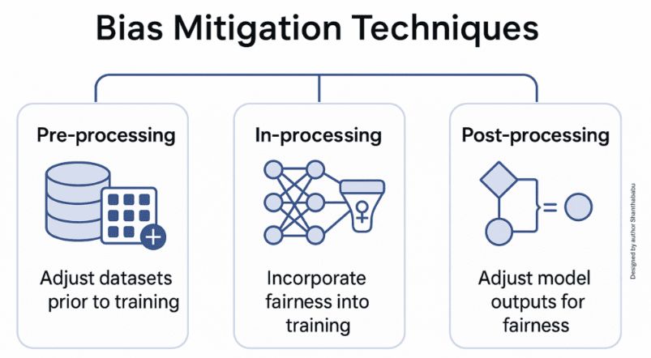
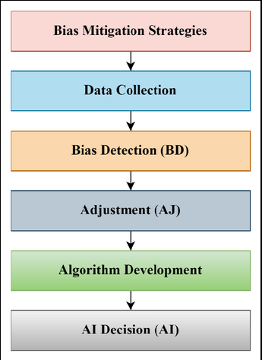

Slide 20
Pre-Processing Mitigation Techniques
Reweighting / re-sampling: adjust weights or oversample underrepresented groups
Data transformation / repair: change feature values to reduce correlation with sensitive attributes
Learning fair representations: learn latent features that obfuscate sensitive attributes
Suppressing / removing sensitive attributes / proxies
Label correction / “massaging”: flipping labels in biased regions

Slide 21
In-Processing Mitigation Techniques
Fairness-aware learning / constraints: include fairness terms in loss function
Adversarial debiasing: train with an adversary that tries to predict sensitive attribute — penalize if it can succeed
Prejudice regularization / discrimination-aware regularization
Group-specific models or parameterization: separate models or constraints per group

Slide 22
Post-Processing Mitigation Techniques
Threshold adjustment per group to equalize metrics (e.g. equal opportunity)
Calibration / calibrated equalized odds
Reject option classification: for uncertain samples, favor disadvantaged group
Output transformation / relabeling: change predictions to satisfy fairness constraints
Example Scenario – Loan Approval
Suppose a model uses features: income, credit history, zip code (proxy for race)
Pre-processing: oversample minority group, remove zip code, reweight samples
In-processing: train with fairness constraint (e.g. equalized odds)
Post-processing: adjust decision thresholds for different groups
Use explainability (e.g. SHAP) to detect if biased features remain

Slide 23
THANK YOU
Team – AI &ML

